Slide 1



WELCOME
BRIKKHAYON
1

Slide 2




Saurav Roy
Roll: 1807084
Department of Computer Science and Engineering
Khulna University of Engineering and Technology
Dabbrata Das
Roll: 1807109
Department of Computer Science and Engineering
Khulna University of Engineering and Technology
Supervised by
Nazia Jahan Khan Chowdhury
Assistant Professor
Department of Computer Science and Engineering
Khulna University of Engineering and Technology
2

Slide 3
Brikkhayon
Make environment greenful
Brikkhayon is an e-commerce based application which specializes in buying and selling plants. The app is developed using dart programming language in Flutter UI toolkit.
3

Slide 4
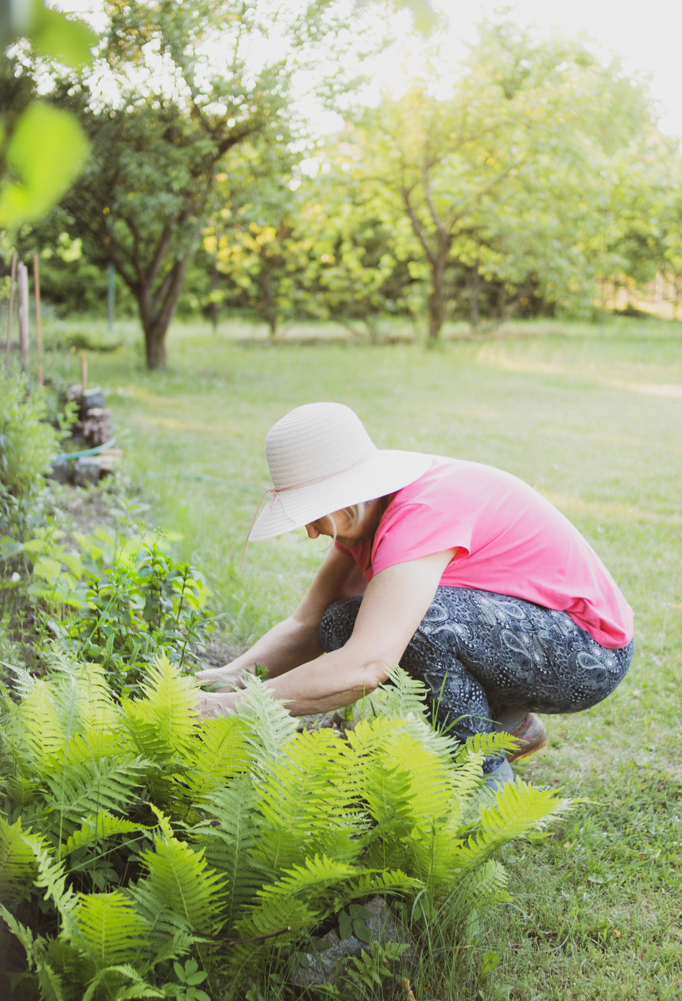
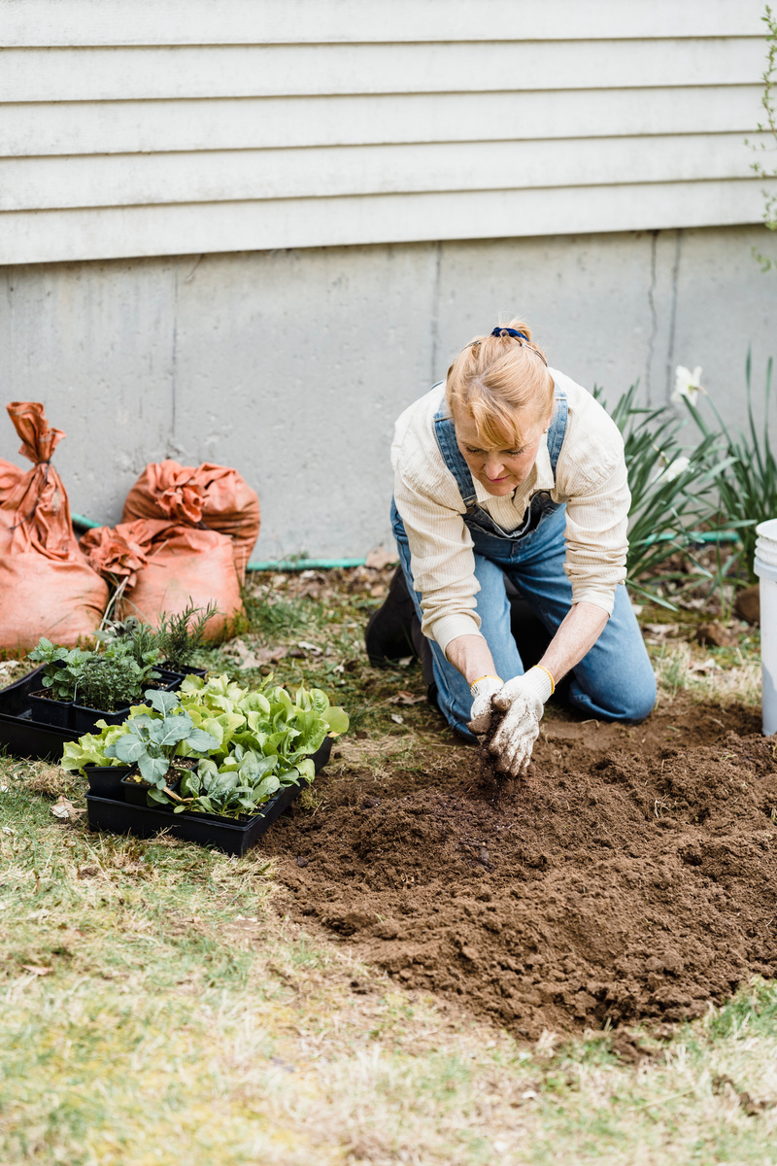
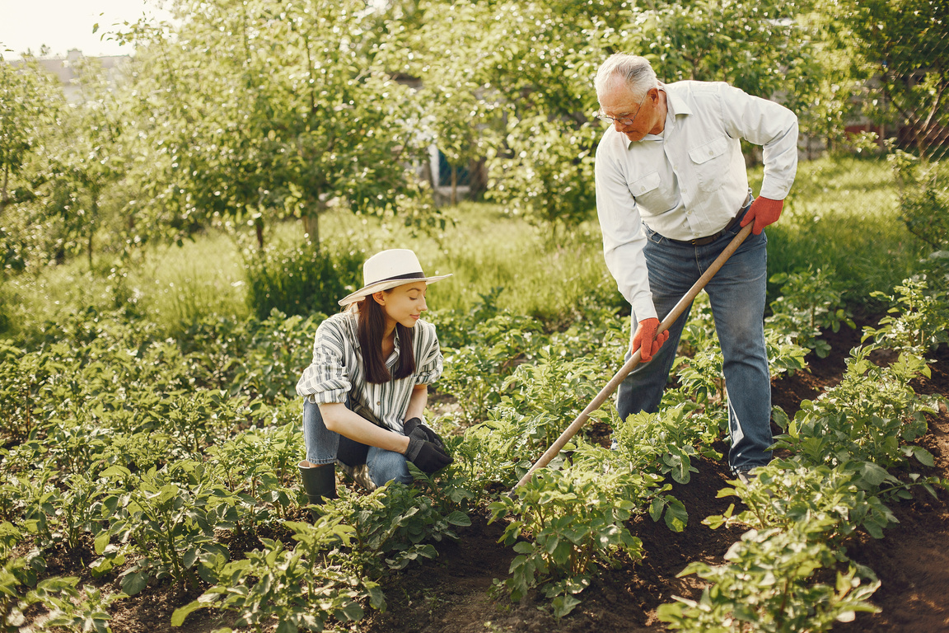
4
Mission and Vision
Mission
The main mission of this project is to make varieties of plants available to the users. The app provides a user friendly environment for the users to do their business. Most of the features are implemented while keeping user comfort in mind.
Vision
The app is developed with an idea about making the environment more beautiful. So far, the project has been both educative and challenging.

Slide 5
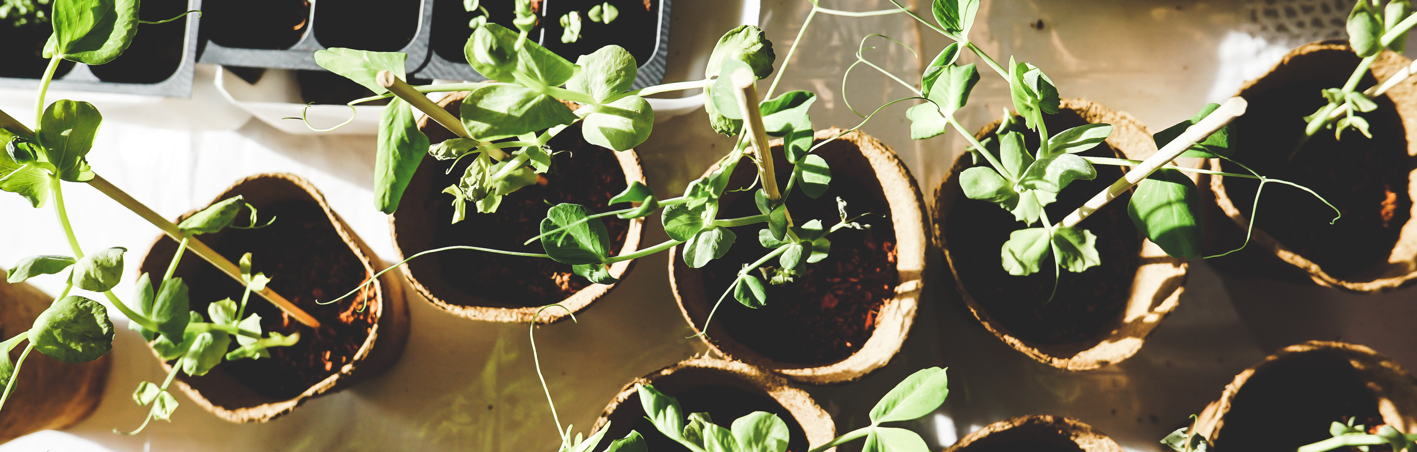


Cross platform
Great State Management
Powerful UI Engine
Fltter provides the functionality to run an app in multiple types of devices, like- Android, iOS, Web Application. It provides a more developer friendly environment since it has a powerful UI Engine. State management functionality is a very helpful feature which makes the coding portion much easier.
Why Flutter!
5

Slide 6
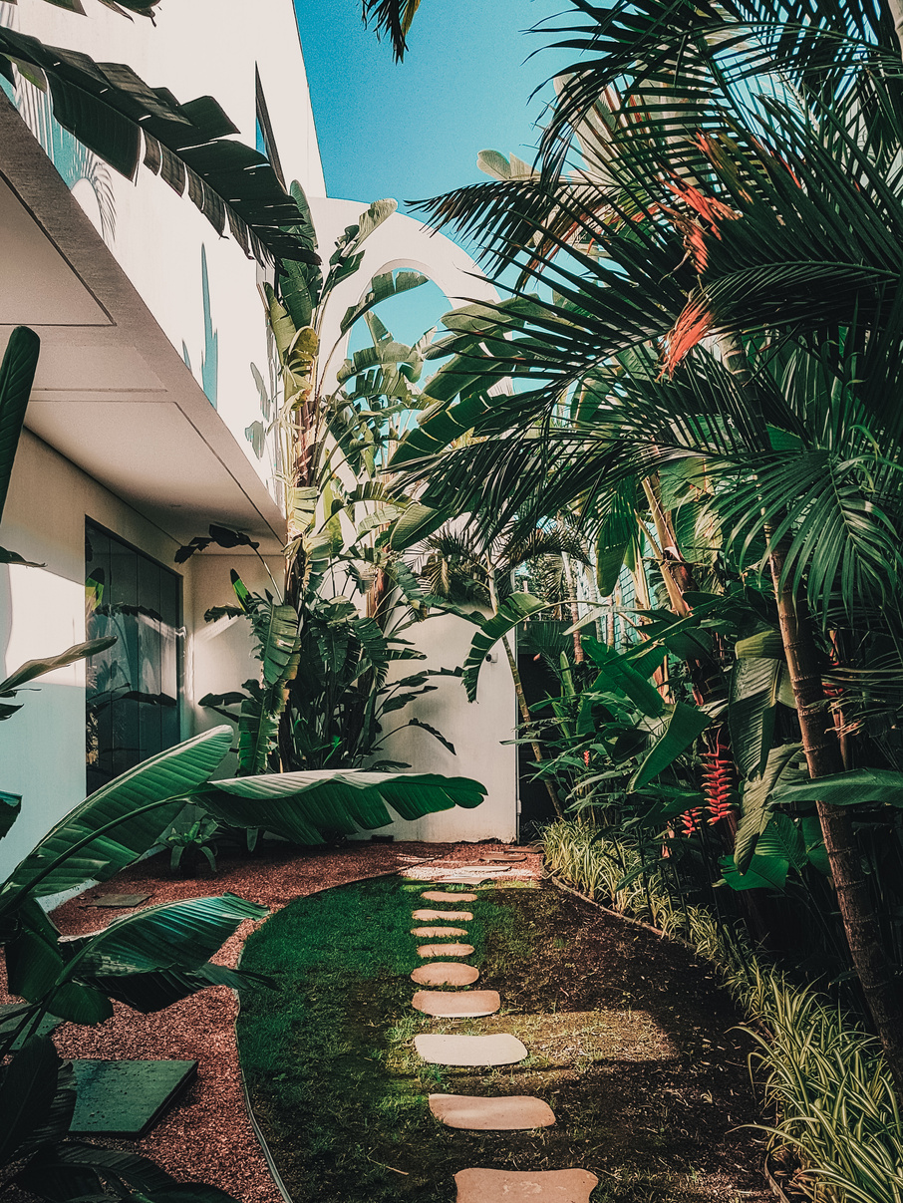
What is special about our app?
Authentication using different types of providers
Database sorted by categories
Chatbot
Plant location in map
Location based searching
Voice recognation based searching
Other basic e-commerce functionalities
6

Slide 7
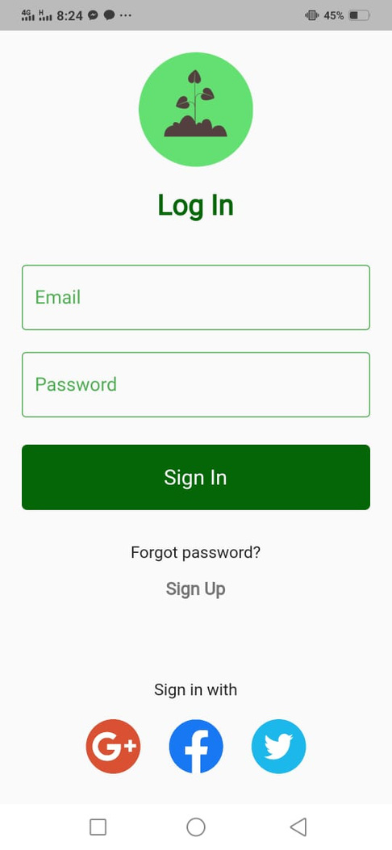
4 different ways to log in!
Email
Google
Facebook
Twitter
7

Slide 8
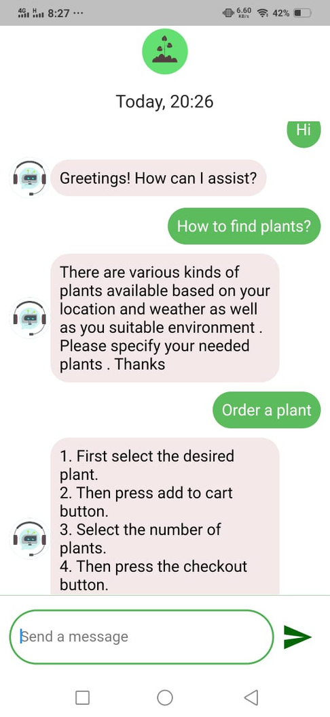

Chatbot
Chatbot is implemented using Dialogflow API. The chatbot can be trained from dialogflow dynamically with numerous questions and answers .
8

Slide 9
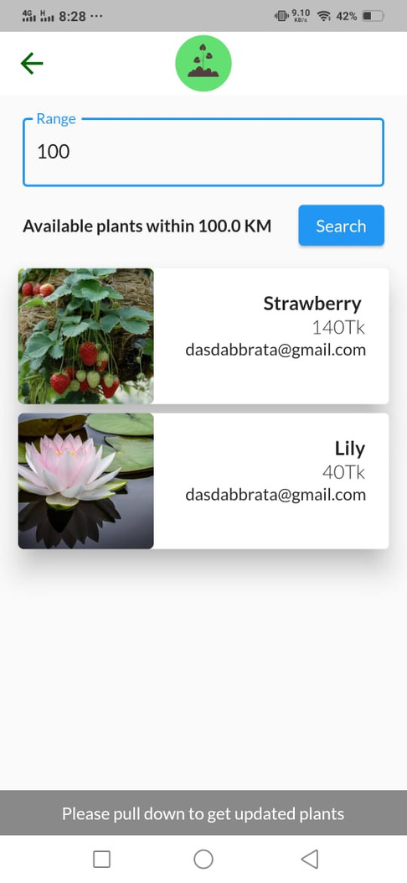

Location based searching
An user can search for plants nearest to his location. He can filter the plant suggestions by providing distance from his current location. This procedure is done using geolocation and geocoding dependencies.
9

Slide 10
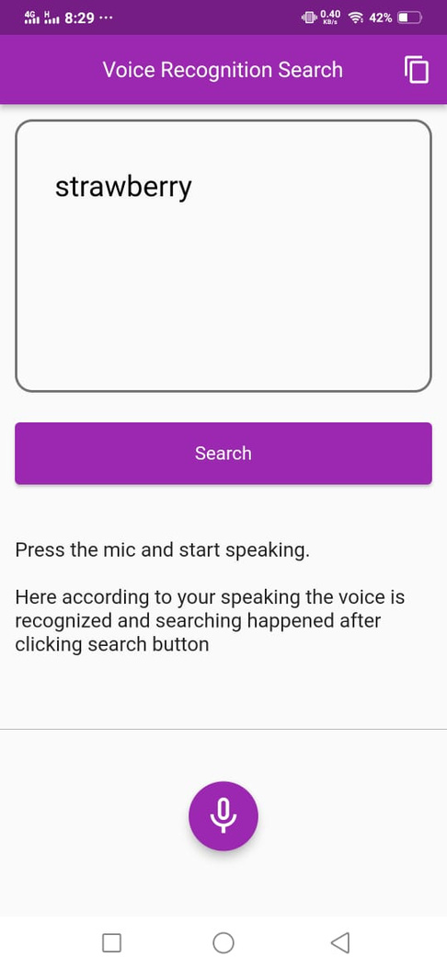

Voice recognition based searching
Flutter package speech-to-text is used to convert voice to text when the button is pressed. Then it can be used to search for plants containing that suffix or prefix.
10

Slide 11
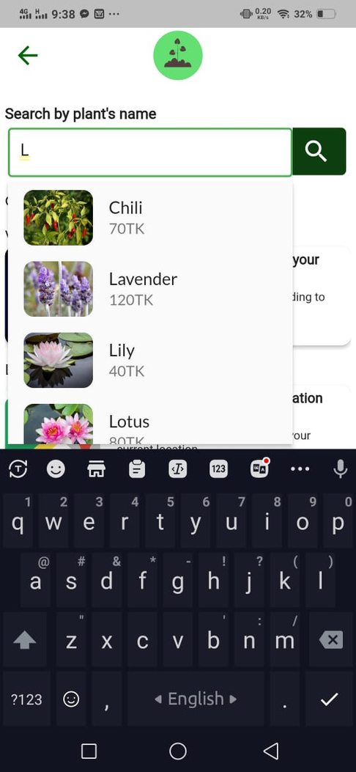
Suggestions when searching
The searching is executed according to suffix and prefix of searched character or string.
11

Slide 12
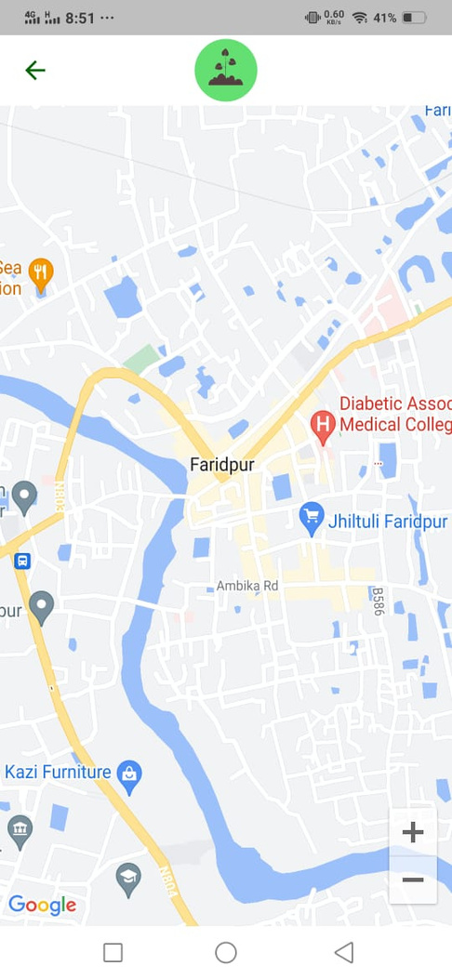

Plant location in map
The location of a plant can be viewed by pressing the 'Find location' button from 'product detail' page.
12

Slide 13
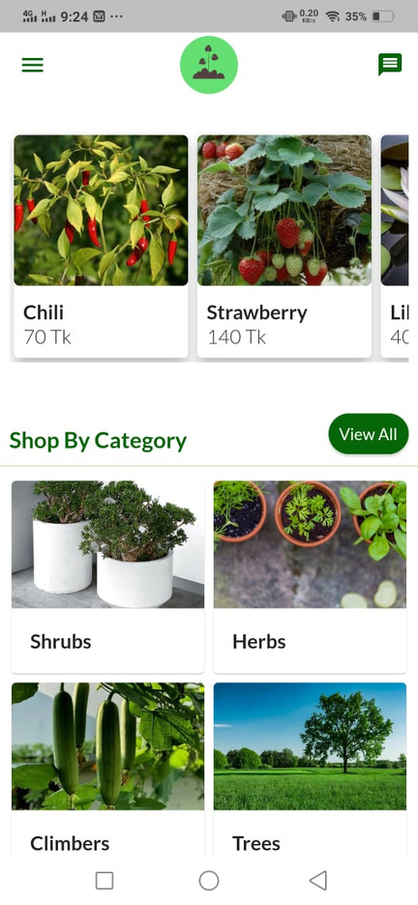
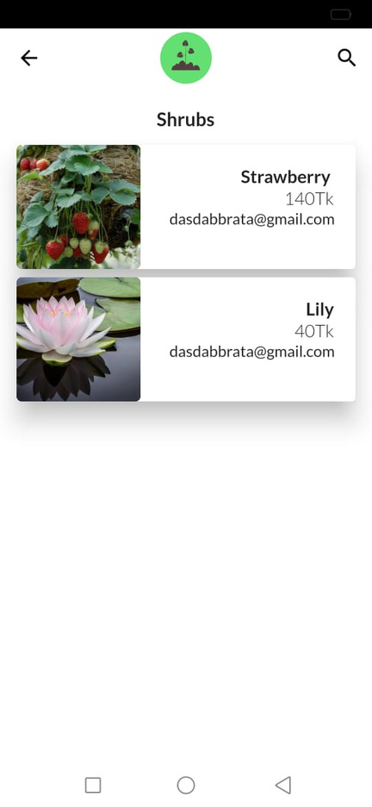
Sorted by categories
Plants are sorted under 4 different types of categories:
Shrubs
Herbs
A shrub is a small to medium sized plant. Shrubs can be either deciduous or evergreen with height less than 6-10 meters tall.
Herbs are widely distributed and widespread group of plants, excluding vegetables.
Climbers
Trees
Climbers are the plants which take some external support to grow vertically, for example: beans, peas, money plants
Trees are the tallest plants among all categories. It plays a significant role in erosion and moderating the climate.
13

Slide 14
Other basic functionalities
Email verification
Plant locations
Cart
An user can not use the app unless he has verified his account. The verification process can be done through email.
Plant locations can be viewed from the plant details page.
An user can use cart option to order multiple items and the order is then stored into database.
User profile
Reset password
User settings
Users can upload their plants from this page. They need to provide the required inputs and also can delete them.
An user can reset their password from settings.
The user can reset their username and password from the page and also can see the uploaded plants and log out.
14

Slide 15
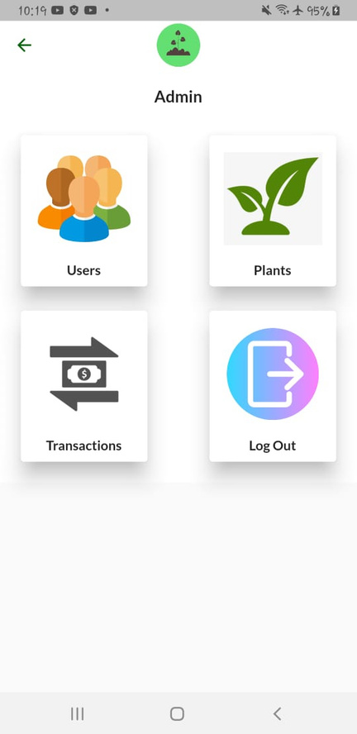
Admin Functionalities
Users
Plants
Admin can see all the users and can also delete them.
Admin can see all the plants from all users here.
Transactions
Sign out
All the transactions can be tracked from here.
Admin can sign out from here
15

Slide 16
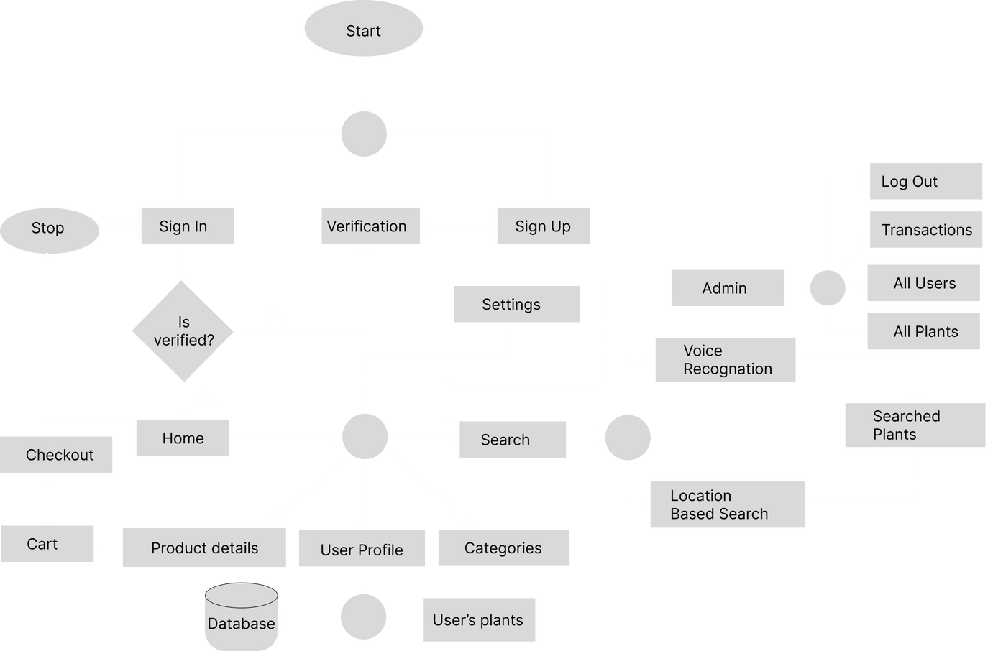
Complete flow chart of our application
16

Slide 17
Limitations
Continuous internet connection needed
No payment gateway implemented
Data fetching latency
Since the app is completely internet dependent, internet connection is a must which might become problematic.
We were unable to add payment gateway functionality due to limited resources.
Some pages may load slower due to data fetching latency. This is dependent on the internet connectivity speed.
17

Slide 18

THANK YOU
18
BRIKKHAYON

